Slide 1
Divide and Conquer

Slide 2
How do you eat an elephant?

Slide 3


Slide 4
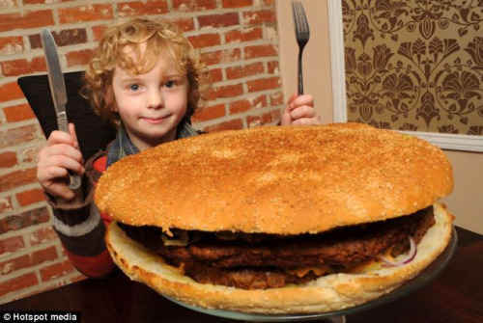
Here is the elephant!

Slide 5
The divide-and-conquer design paradigm
Divide the problem (instance) into subproblems.
Conquer the subproblems by solving them recursively.
Combine subproblem solutions.

Slide 6
Binary search
Find an element in a sorted array:
1. Divide: Check middle element.
2. Conquer: Recursively search 1 subarray.
3. Combine: Trivial.
Example: Find 9
3 5 7 8 9 12 15

Slide 7
Binary search
Find an element in a sorted array:
1. Divide: Check middle element.
2. Conquer: Recursively search 1 subarray.
3. Combine: Trivial.
Example: Find 9
3 5 7 8 9 12 15

Slide 8
Binary search
Find an element in a sorted array:
1. Divide: Check middle element.
2. Conquer: Recursively search 1 subarray.
3. Combine: Trivial.
Example: Find 9
3 5 7 8 9 12 15

Slide 9
Binary search
Find an element in a sorted array:
1. Divide: Check middle element.
2. Conquer: Recursively search 1 subarray.
3. Combine: Trivial.
Example: Find 9
3 5 7 8 9 12 15

Slide 10
Binary search
Find an element in a sorted array:
1. Divide: Check middle element.
2. Conquer: Recursively search 1 subarray.
3. Combine: Trivial.
Example: Find 9
3 5 7 8 9 12 15

Slide 11
Binary search
Find an element in a sorted array:
1. Divide: Check middle element.
2. Conquer: Recursively search 1 subarray.
3. Combine: Trivial.
Example: Find 9
3 5 7 8 9 12 15

Slide 12
Recurrence for binary search
T(n) = 1 T(n/2) + Θ(1)
⇒ T(n) = Θ(lg n) .
# subproblems
work dividing
and combining
subproblem size

Slide 13
MergE Sort
The key to Merge Sort is merging two sorted lists into one, such that if you have two lists X (x₁≤x₂≤…≤x_{m}) and Y(y₁≤y₂≤…≤y_{n}) the resulting list is Z(z₁≤z₂≤…≤z_{m+n})
Example:
L₁ = { 3 8 9 } L₂ = { 1 5 7 }
merge(L₁, L₂) = { 1 3 5 7 8 9 }

Slide 14
Merging
X:
3 | 10 | 23 | 54
Y:
1 | 5 | 25 | 75
Result:

Slide 15
Merging
X:
3 | 10 | 23 | 54
Y:
 | 5 | 25 | 75
Result:
1

Slide 16
Merging
X:
 | 10 | 23 | 54
Y:
 | 5 | 25 | 75
Result:
1 | 3

Slide 17
Merging
X:
 | 10 | 23 | 54
Y:
 |  | 25 | 75
Result:
1 | 3 | 5

Slide 18
Merging
X:
 |  | 23 | 54
Y:
 |  | 25 | 75
Result:
1 | 3 | 5 | 10

Slide 19
Merging
X:
 |  |  | 54
Y:
 |  | 25 | 75
Result:
1 | 3 | 5 | 10 | 23

Slide 20
Merging
X:
 |  |  | 54
Y:
 |  |  | 75
Result:
1 | 3 | 5 | 10 | 23 | 25

Slide 21
Merging
X:
Y:
 |  |  | 75
Result:
1 | 3 | 5 | 10 | 23 | 25 | 54

Slide 22
Merging
X:
Y:
Result:
1 | 3 | 5 | 10 | 23 | 25 | 54 | 75

Slide 23
Merge Sort
MergeSort(A, left, right) {
if (left < right) {
mid = floor((left + right) / 2);
MergeSort(A, left, mid);
MergeSort(A, mid+1, right);
Merge(A, left, mid, right);
}
}
// Merge() takes two sorted subarrays of A and
// merges them into a single sorted subarray of A
// (how long should this take?) Look at Previous Slides

Slide 24
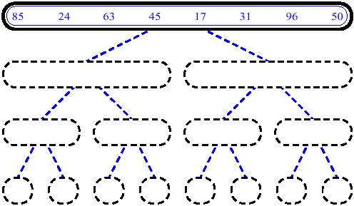
MergeSort - 1

Slide 25
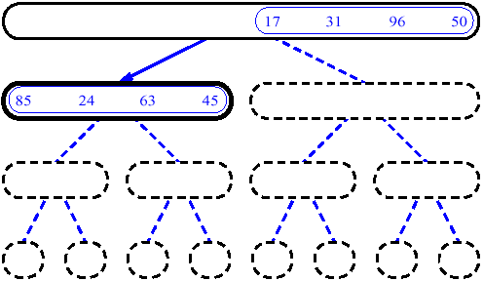
MergeSort - 2

Slide 26
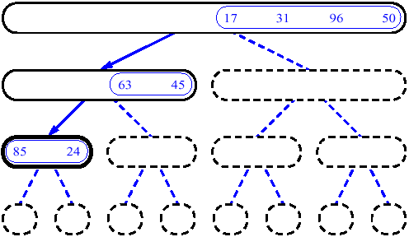
MergeSort - 3

Slide 27
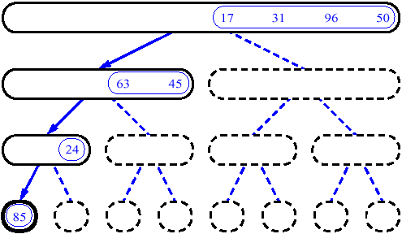
MergeSort - 4

Slide 28
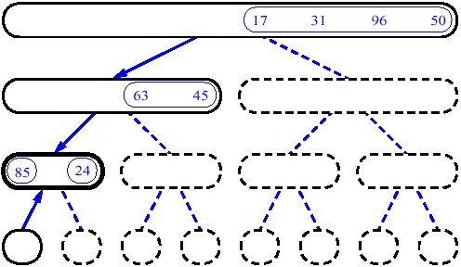
MergeSort - 5

Slide 29
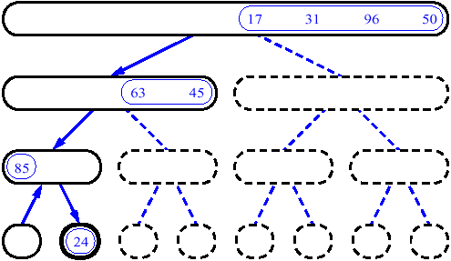
MergeSort - 6

Slide 30
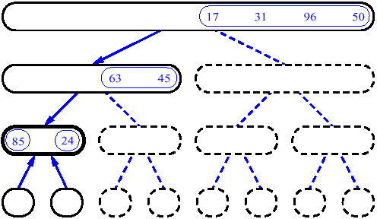
MergeSort - 7

Slide 31
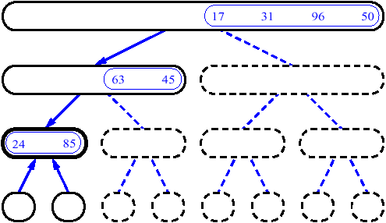
MergeSort - 8

Slide 32
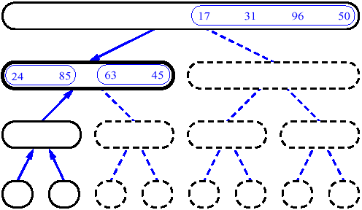
MergeSort - 9

Slide 33
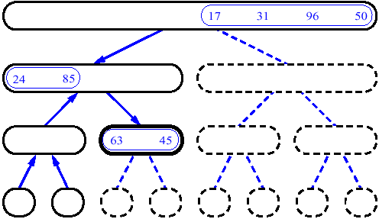
MergeSort - 10

Slide 34
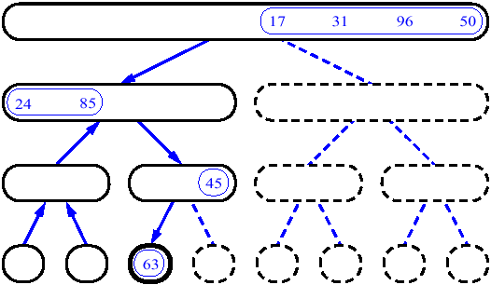
MergeSort - 11

Slide 35
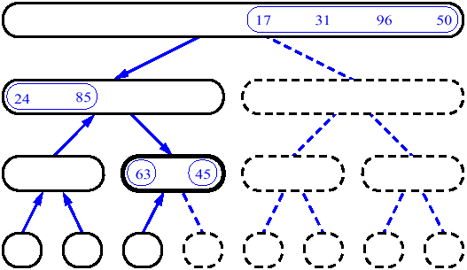
MergeSort - 12

Slide 36
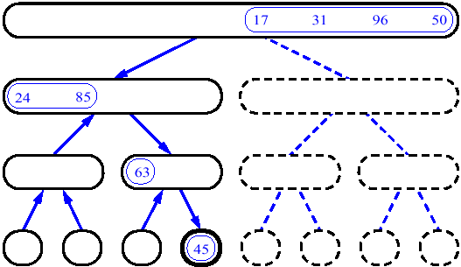
MergeSort - 13

Slide 37
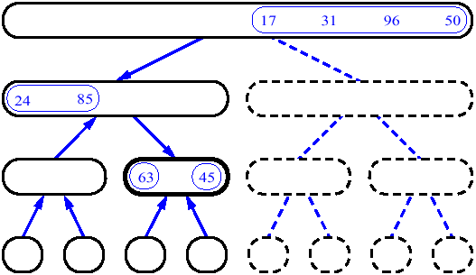
MergeSort - 14

Slide 38
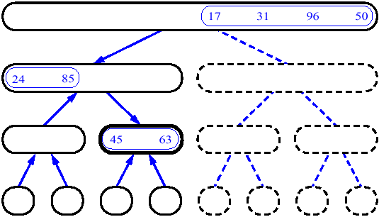
MergeSort - 15

Slide 39
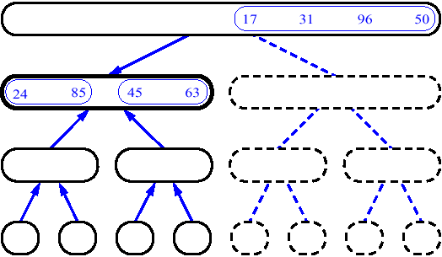
MergeSort - 16

Slide 40
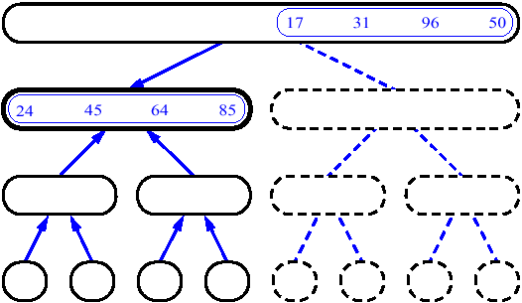
MergeSort - 17

Slide 41
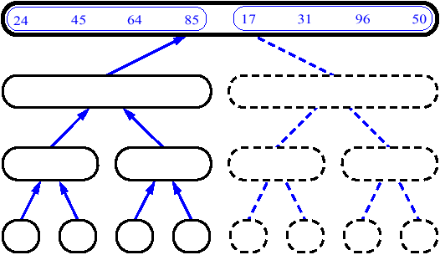
MergeSort - 18

Slide 42
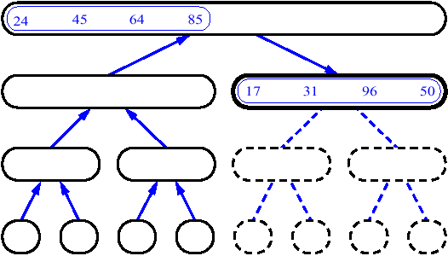
MergeSort - 19

Slide 43
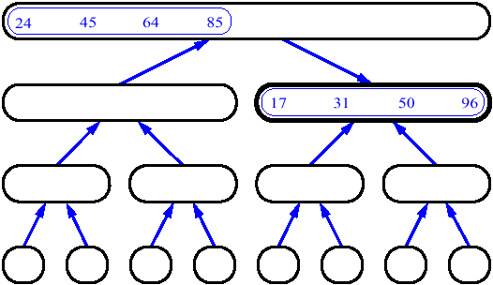
MergeSort - 20

Slide 44
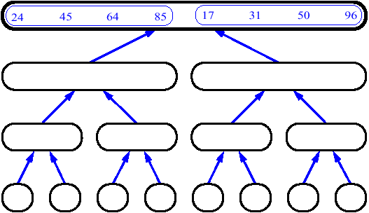
MergeSort - 21

Slide 45
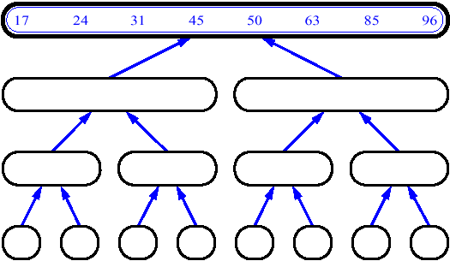
MergeSort - 22

Slide 46
Merge Sort: Example
Show MergeSort() running on the array A = {10, 5, 7, 6, 1, 4, 8, 3, 2, 9};

Slide 47
Analysis of Merge Sort
Statement Effort
So T(n) = Θ(1) when n = 1, and
2T(n/2) + Θ(n) when n > 1
So what (more succinctly) is T(n)?
MergeSort(A, left, right) { T(n)
if (left < right) { Θ(1)
mid = floor((left + right) / 2); Θ(1)
MergeSort(A, left, mid); T(n/2)
MergeSort(A, mid+1, right); T(n/2)
Merge(A, left, mid, right); Θ(n)
}
}

